Slide 1
Λproduction in FINUDA
Λproduction reactions;
Λ selection;
Λproduction as a function of A.
P.Gianotti

Slide 2
Λ production reactions
A K⁻ interacting inside a nucleus can produce a Λ via the following reactions:
Then Λ is reconstructed via its decay into a proton and a negative pion.

Slide 3
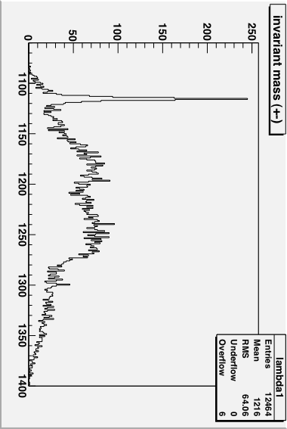
Λ selection
We looked at events produced at the K⁻ interaction vertex with at least a proton and a negative pion and we reconstruct invariant mass
2003 data sample

Slide 4
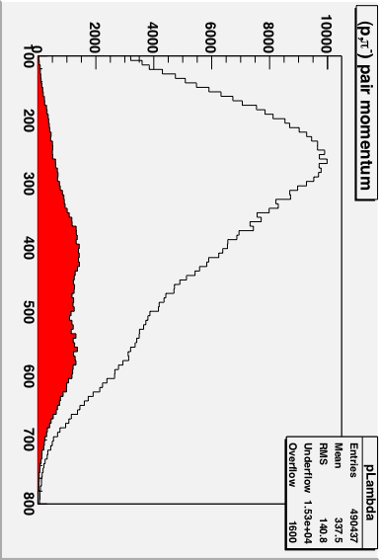
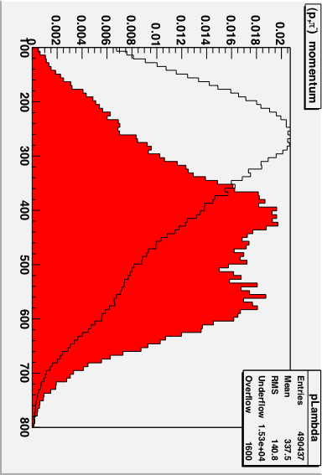
Λ momentum 2006 data
In black the momentum of the (p,π⁻) “particle”
In red the same quantity for inv.mass in the Λrange
Histograms are normalized to the same scale

Slide 5
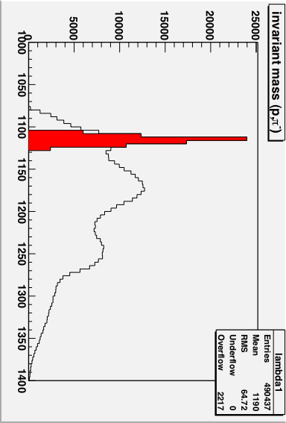
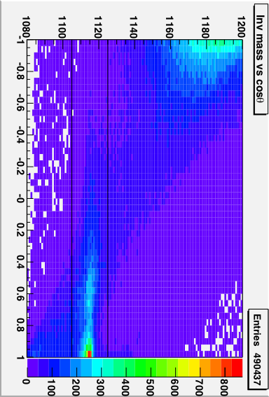
Tight selections
π⁻
^{θ}
p
Λ
2006 data sample

Slide 6
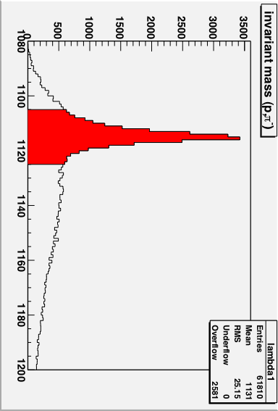
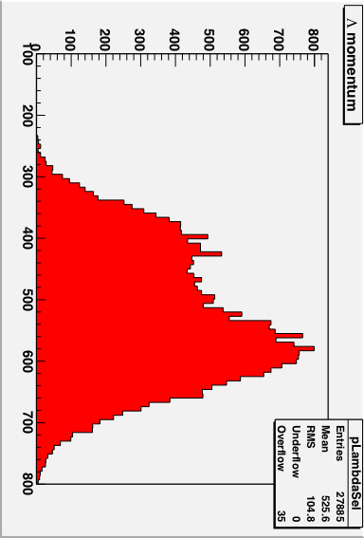
Results of the tight selection
cosθ>0
2003 data sample

Slide 7
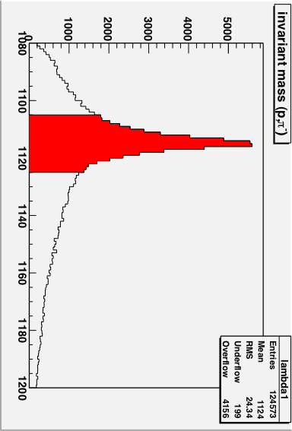
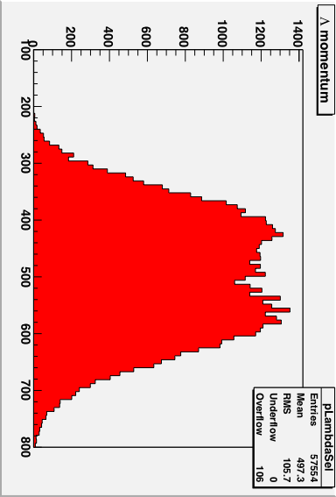
Results of the tight selection
cosθ>0
2006 data sample

Slide 8
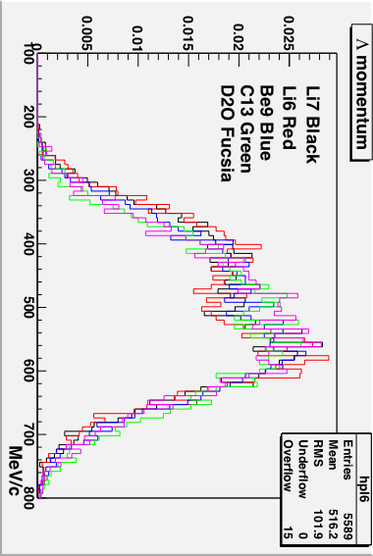
Λmomenta for 2006 targets

Slide 9
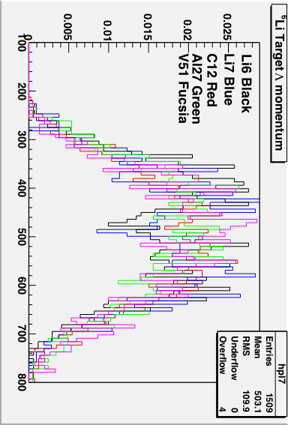
Λmomenta for 2003 targets

Slide 10
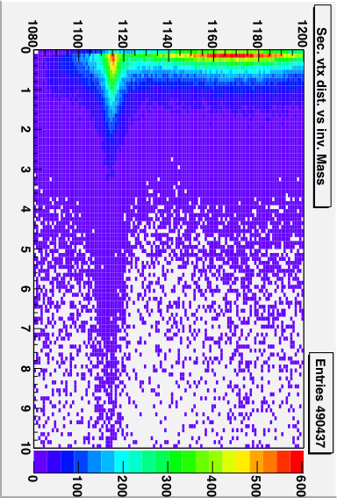
Secondary vertex selection

Slide 11
Study of Λmomentum
We want to understand the nature of the 2 bumps in the Λ momentum spectrum.
Coming back to Λ production, we know that there are 2 kinds of reactions
1)
2)
for 1) just one proton is present in the final state
for 2) two protons can be present

Slide 12
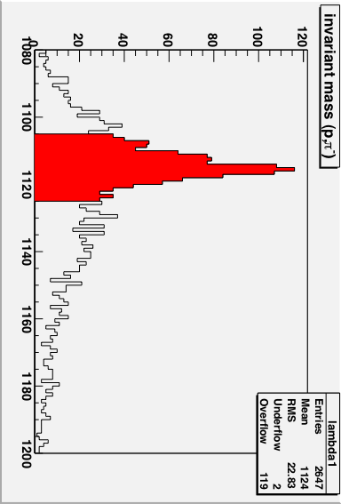
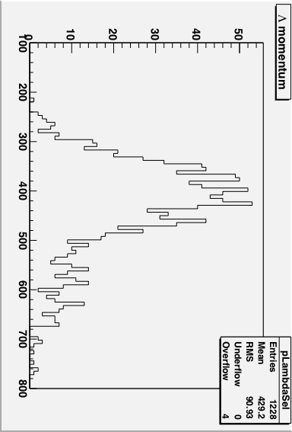
Λproduction on one nucleon
by selecting events with just one proton in the final state
and one or two negative pions we obtain:

Slide 13
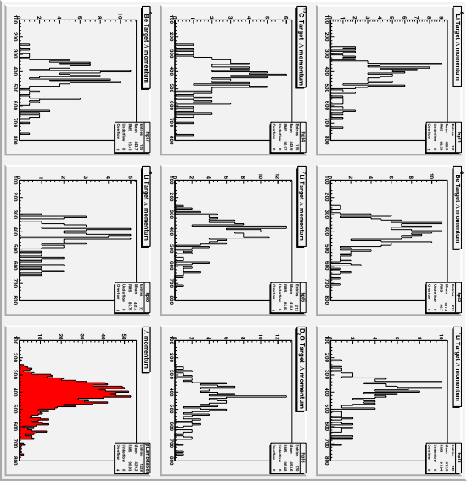
Target by Target

Slide 14
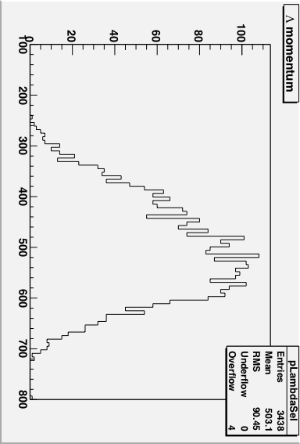
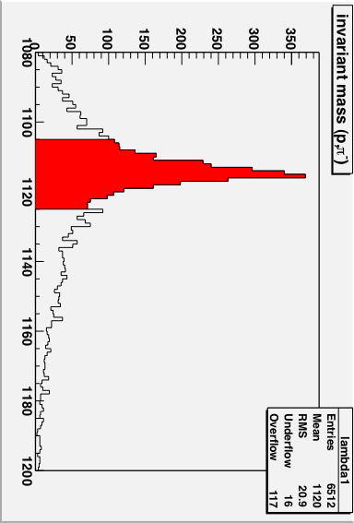
Λproduction on two nucleons
by selecting events with just two protons in the final state
and one or one negative pion we obtain:

Slide 15
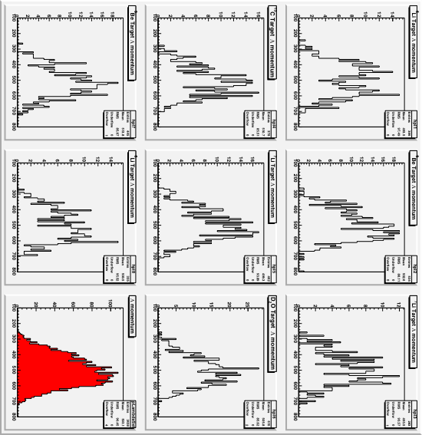
Target by Target

Slide 16
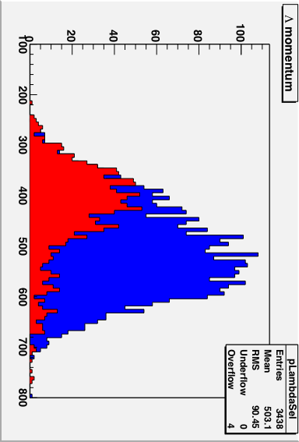
Comparison
RED Λ momentum for events with just one pion
BLUE Λ momentum for events with just one proton

