Slide 1
Magnetic and Electronic Quasiparticle
Spectra of Iron Pnictides*
E.C.Marino
UFRJ
Rio de Janeiro, Brazil
*C.M.S da Conceição, M.B Silva Neto, E.C. Marino
Phys. Rev. Lett. 106 , 117002 (2011)

Slide 2
Summary
Introduction
Phenomenology
The Model
The Quantum Field Theory Approach
Magnetic Spectrum
Electronic Spectrum
Concluding Remarks and Prospects

Slide 3
Introduction
What are the most beautiful and interesting phenomena in Physics?
My personal choice:
a) Quarks and the theories describing their interactions
b) Superconductivity
But…. There is an objective way of measuring………………………!!!!

Slide 4
List of Nobel Prizes for Superconductivity (Total of 7)
2
1
2
1
1
2003 [1950] Alexei A. Abrikosov , Vitaly L. Ginzburg - Pioneering contributions to the theory of superconductors
1987 [1986] Georg Bednorz, Alex K. Müller - High-temperature superconductivity
1973 [1960] Leo Esaki, Ivar Giaever - Tunneling in superconductors
[1962] Brian D. Josephson - Super-current through tunnel barriers
1972 [1957] John Bardeen, Leon N. Cooper and J. Robert Schrieffer - Theory of superconductivity
1913 [1911] Heike Kamerlingh Onnes - Matter at low temperature (discovery of SC in Hg)

Slide 5
List of Nobel Prizes for Quarks and the Theories that describe them (Total of 8)
1
1
1
1
1
1
1
1
1969 [1964] Murray Gell-Mann - Quark model for particle classification
1976 [1974] Burton Richter, Samuel Ting -Discovery of the J/Psi particle
1979 [1961] Sheldon Glashow
[1967] Steven Weinberg
[1968] Abdus Salam - Electroweak theory
1984 [1983] Carlo Rubbia - Discovery of W and Z particles
1990 [1972] Jerome Friedman , Henry Kendall, Richard Taylor - Deep inelastic scattering experiments leading to the discovery of quarks
1999 [1972] Gerard 't Hooft, Martin Veltman - Development of a renormalization scheme for non-abelian gauge theories
2004 [1973] David J. Gross H, David Politzer , Frank Wilczek - Discovery of asymptotic freedom in the theory of the strong interaction.
2008 Makoto Kobayashi, Toshihide Maskawa - Discovery of the origin of symmetry breaking.

Slide 6
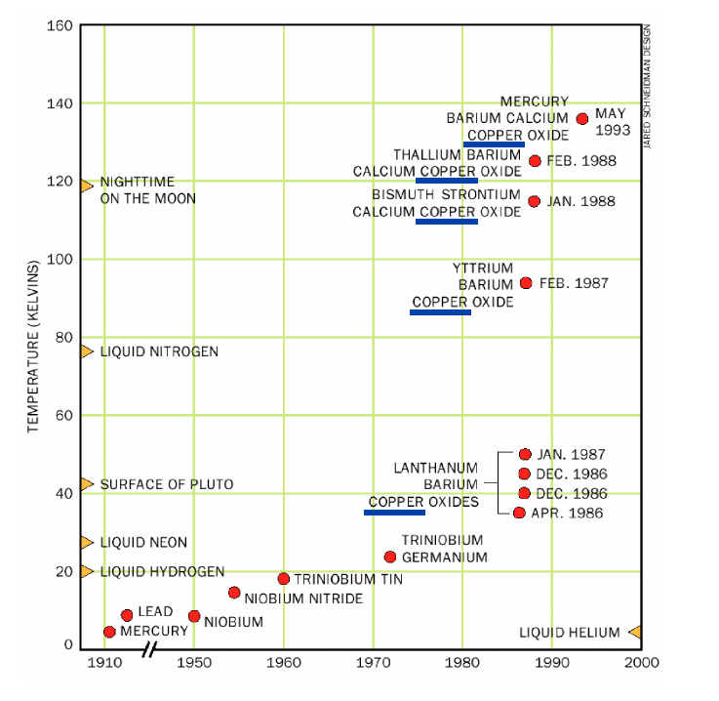
2) Phenomenology
Superconductors of the 20th. Century

Slide 7
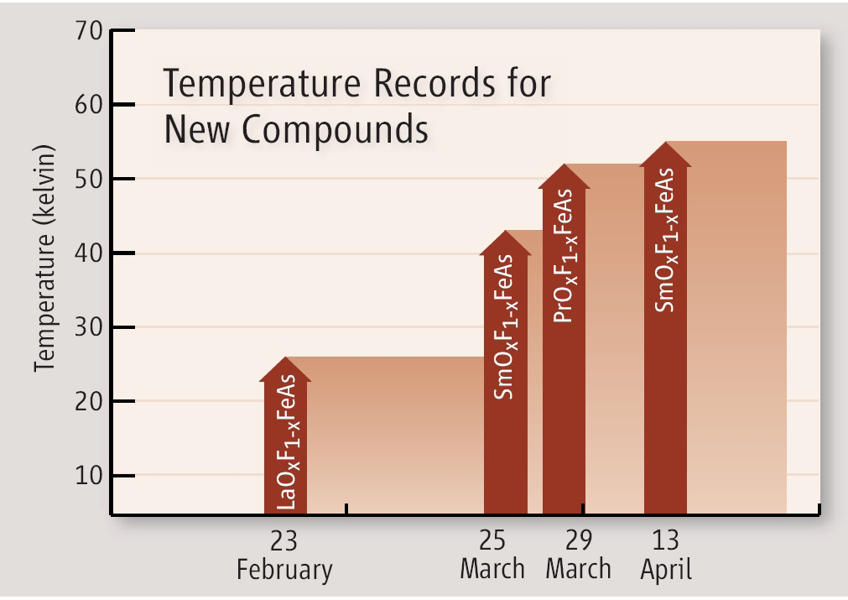
Pnictides: High-Tc Supercondutors of the 21st Century
2008
Y. Kamihara, T.Watanabe, M.Hirano and H. Hosono;
J.Am.Chem. Soc. 130 (2008) 3296

Slide 8
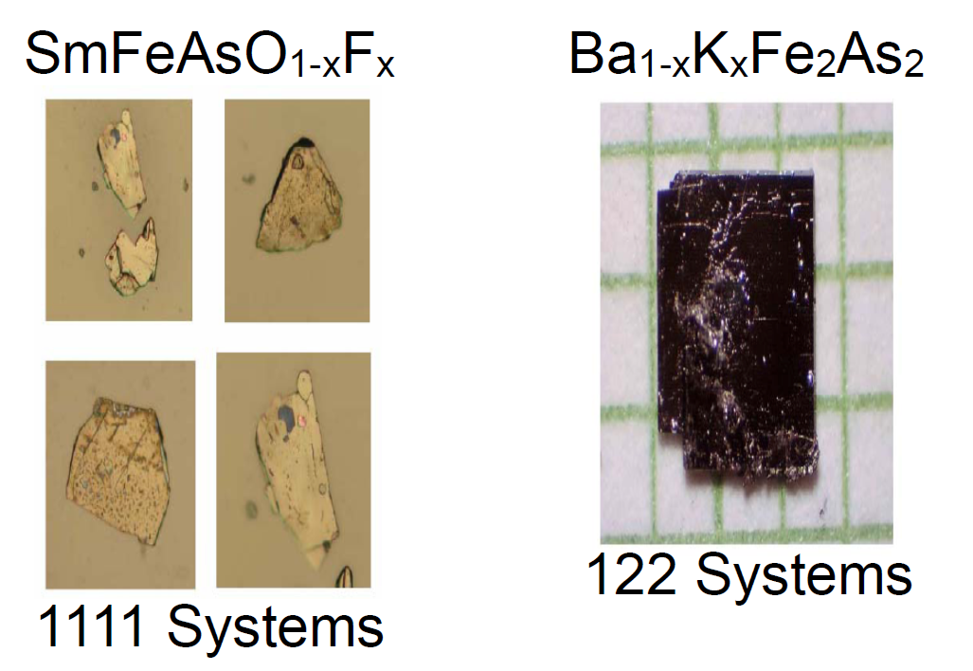
The Pnictides

Slide 9
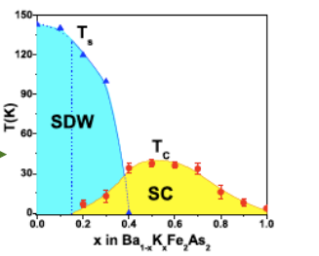
Phase Diagram of an 122 material

Slide 10
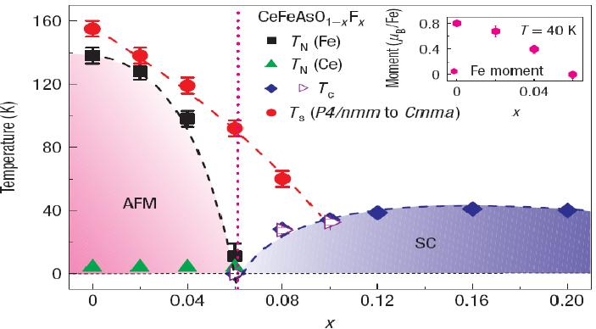
Phase Diagram of an 1111 material

Slide 11
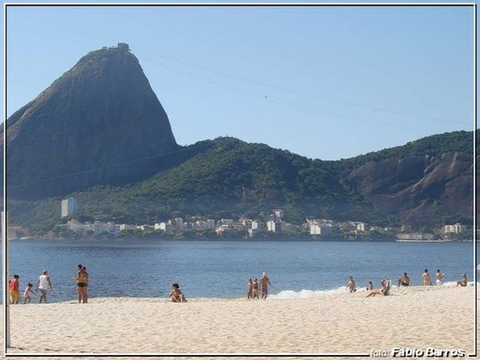
Something....
... to do with Rio de Janeiro?

Slide 12
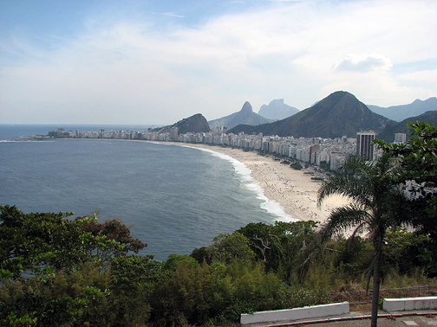


Yes…..in spite of that we can do good physics!!!

Slide 13
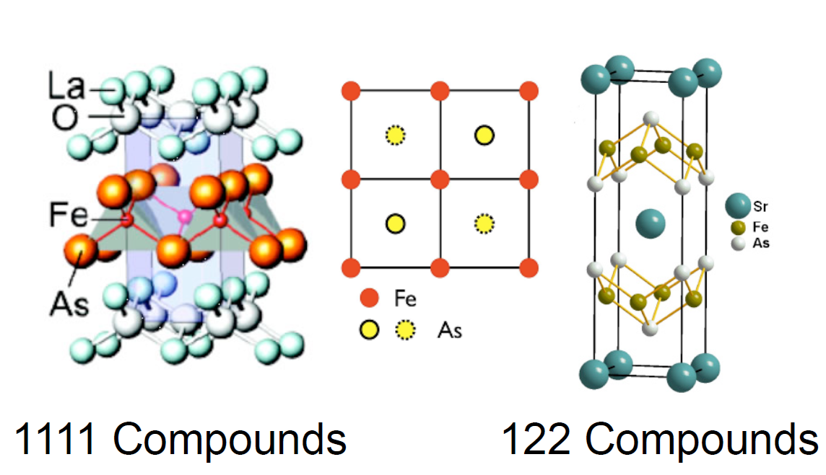
Crystal Structure

Slide 14
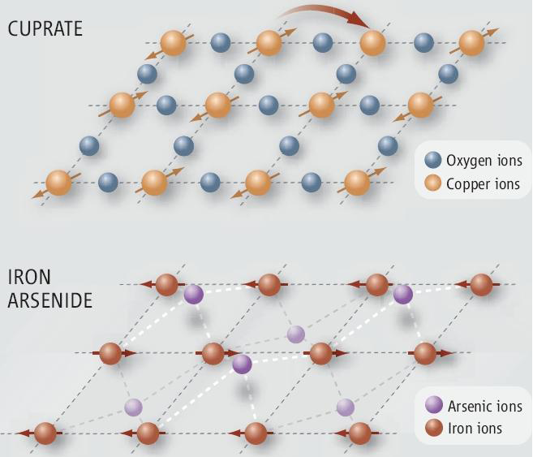
Comparing Structures of Pnictides and Cuprates

Slide 15
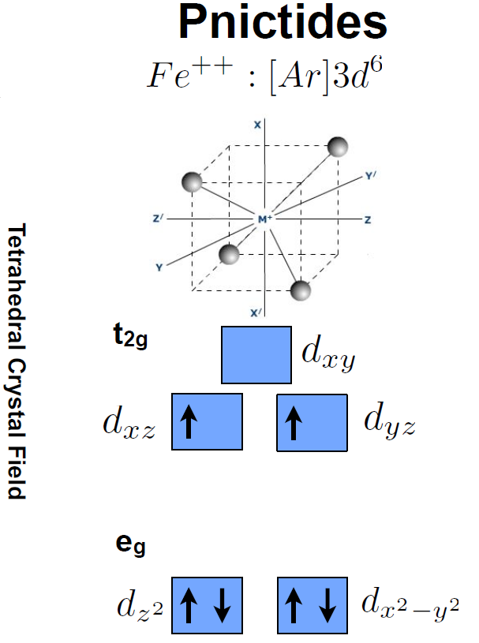
Electronic Structure
Fe++ has
Spin = 1

Slide 16
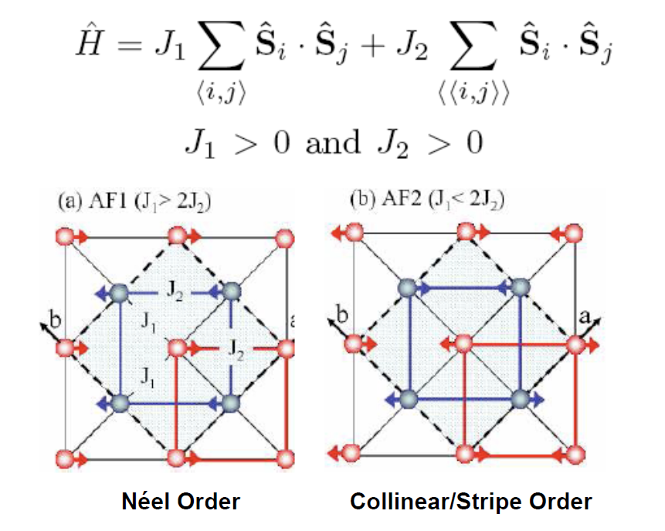
3) The Model
Magnetic
Ground States

Slide 17
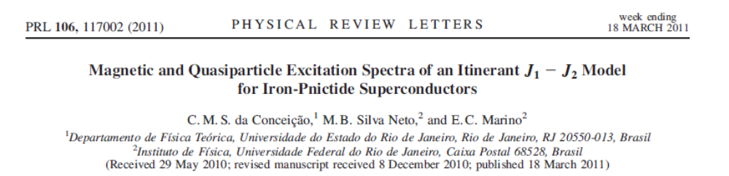
Phys. Rev. Lett. 106, 117002 (2011)
Magnetic and Quasiparticle Excitation Spectra of an Itinerant J₁-J₂ Model for Iron-Pnictide Superconductors
C. M. S. da Conceição, M. B. Silva Neto and E. C. Marino

Slide 18
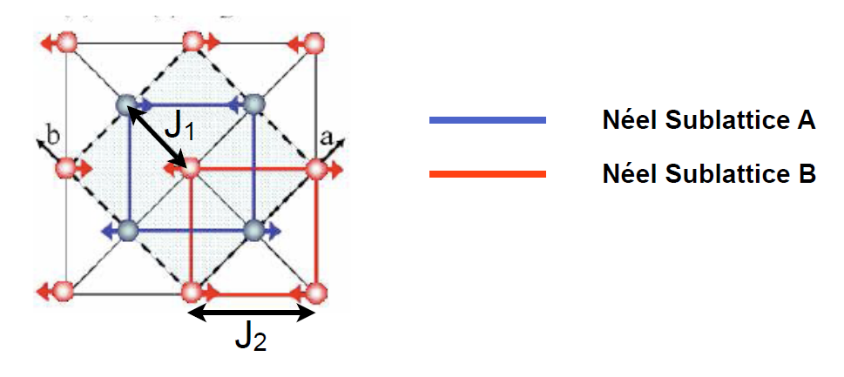
For J₁ < 2 J₂

Slide 19

Localized Spins
Spin-Orbit +
Relativistic

Slide 20



Itinerant electrons
Itinerant electrons-localized spins interaction

Slide 21
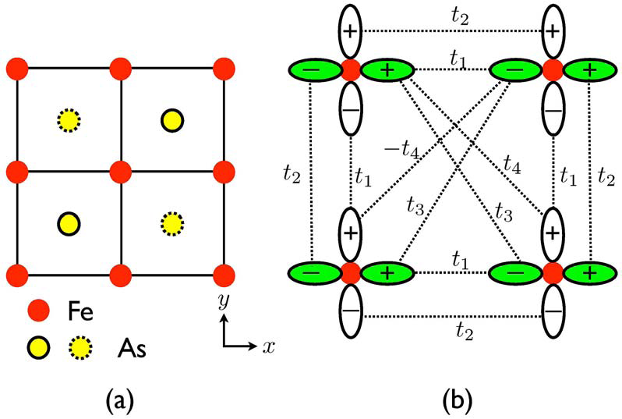
The Hopping Amplitudes
S. Raghu et al., Phys. Rev. B77, 220503 (2008)

Slide 22

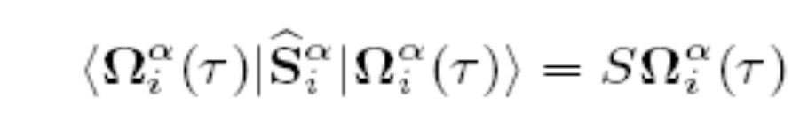

4) The Quantum Field Theory Approacah
Using Coherent Spin States
Spin operatorof Fe++
For evaluating the Partition Function
To begin with: just
localized H, K=0

Slide 23

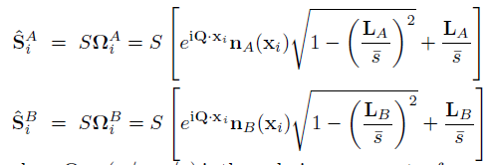
We obtain
Decomposing in AF and F fluctuations
... and integrating on L_{A} , L_{B}

Slide 24
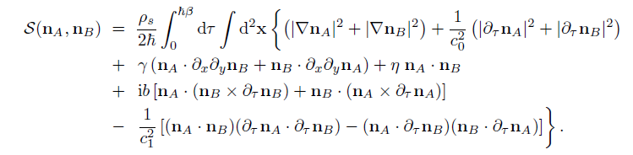
Quantum Field Theory Action
Obtained after integration over the ferromagnetic fluctuations
Quantum Effects are included!!!

Slide 25
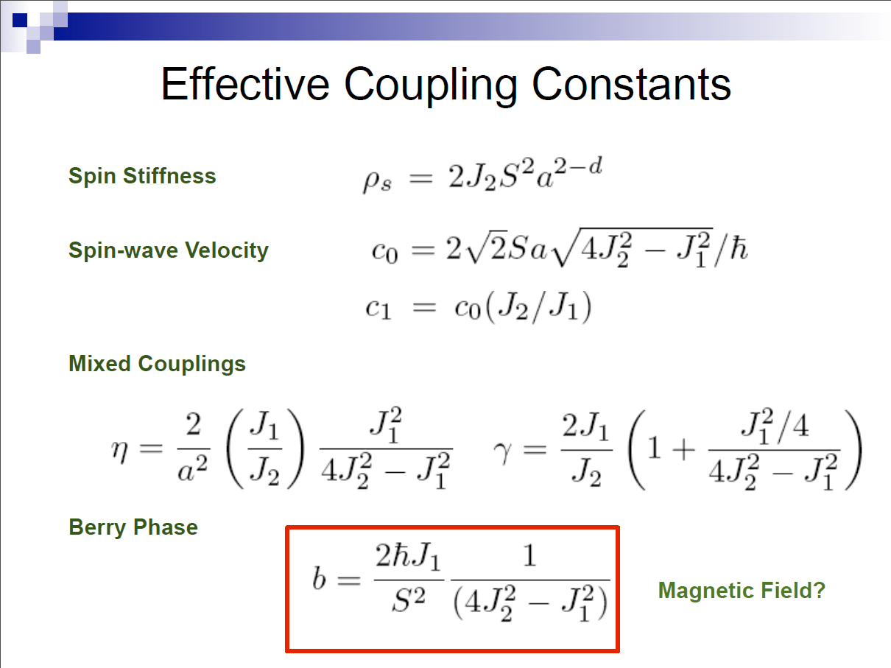
Relevant Parameters

Slide 26
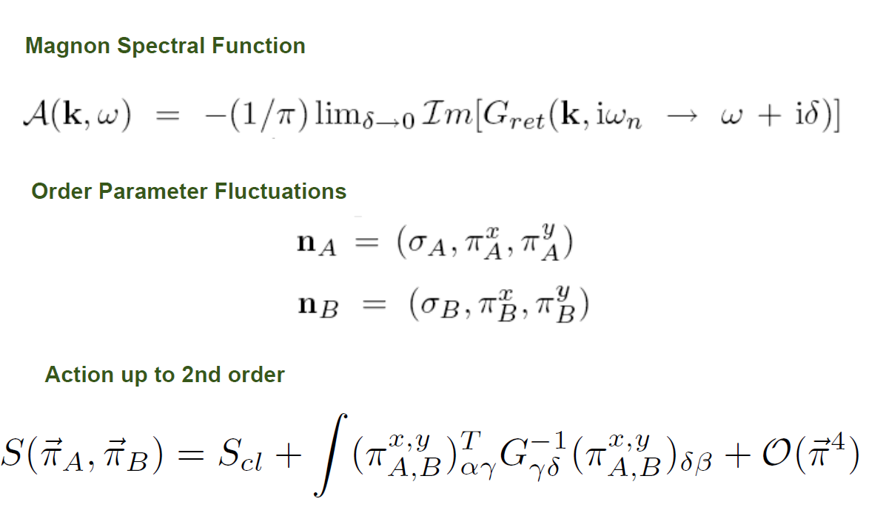
5) Magnetic Spectrum
Magnons: π-field fluctuation

Slide 27
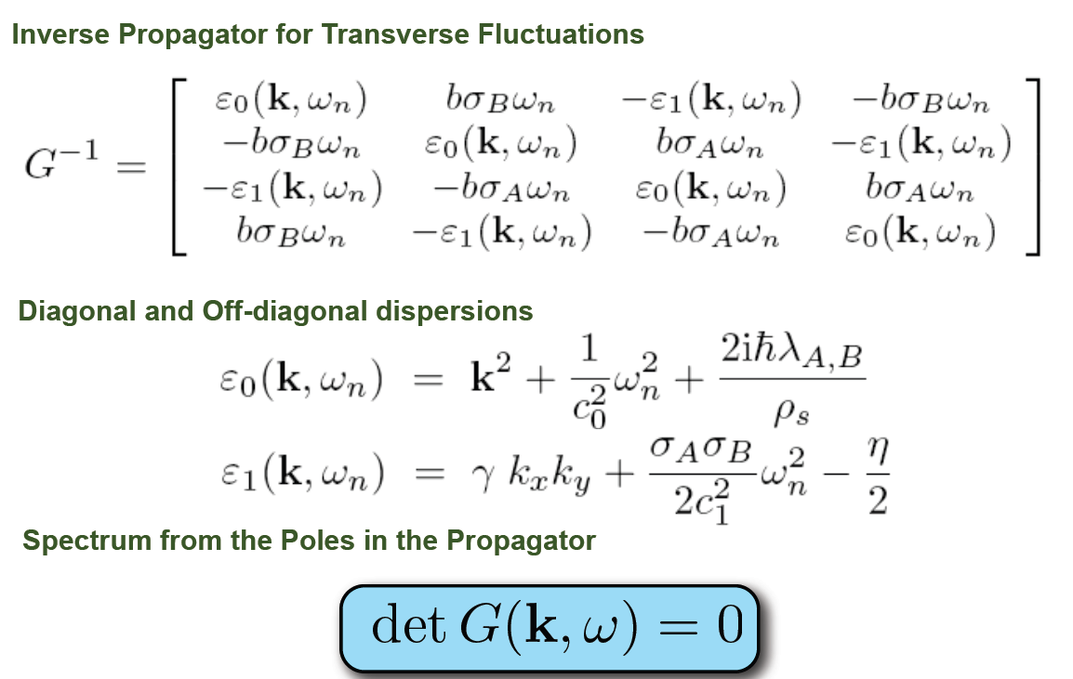
π-field

Slide 28
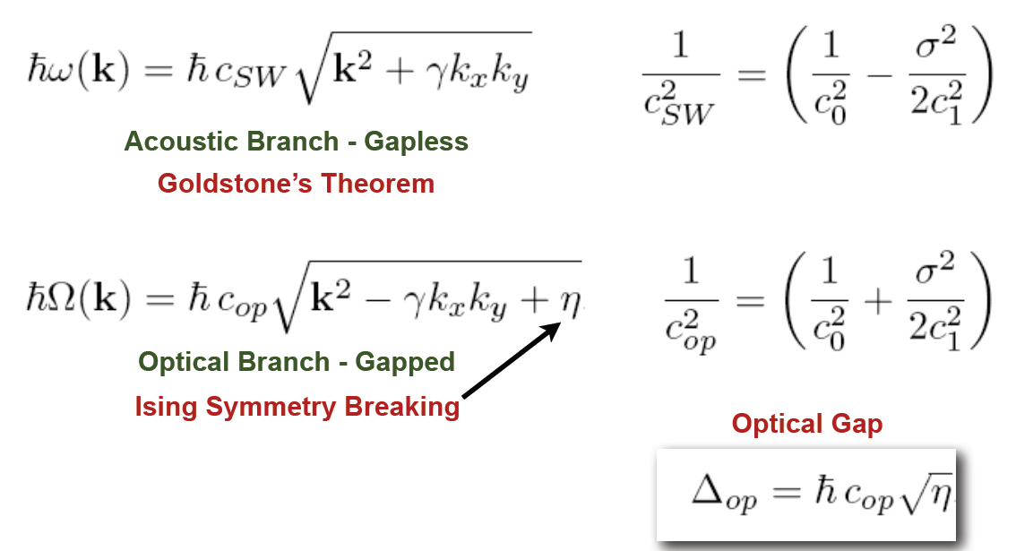
Magnon dispersion relations

Slide 29
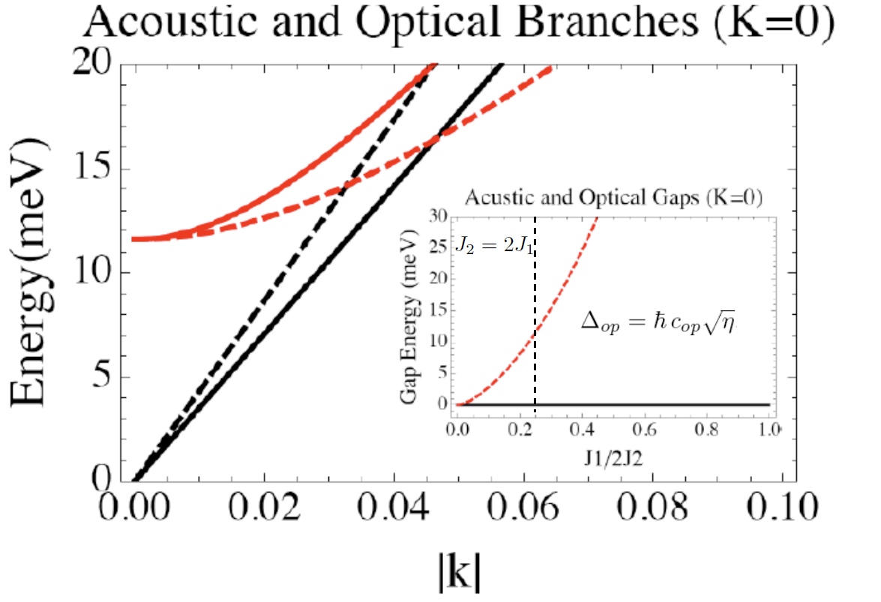
Solid line: k_{y} =0
Dashed line: k_{x} = k_{y}

Slide 30
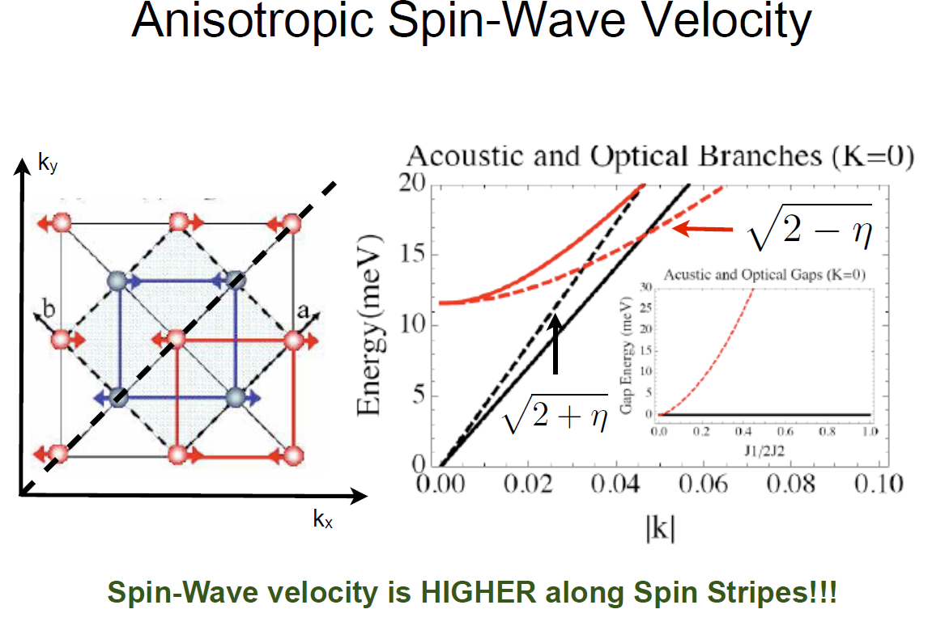

Slide 31
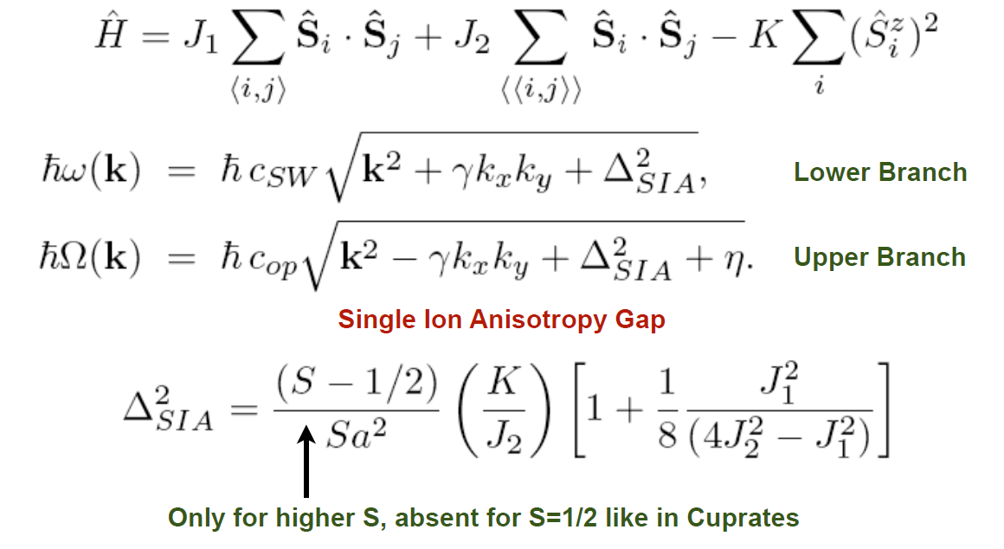
Spin-Orbit +
Relativistic
Improved Model , K≠0

Slide 32
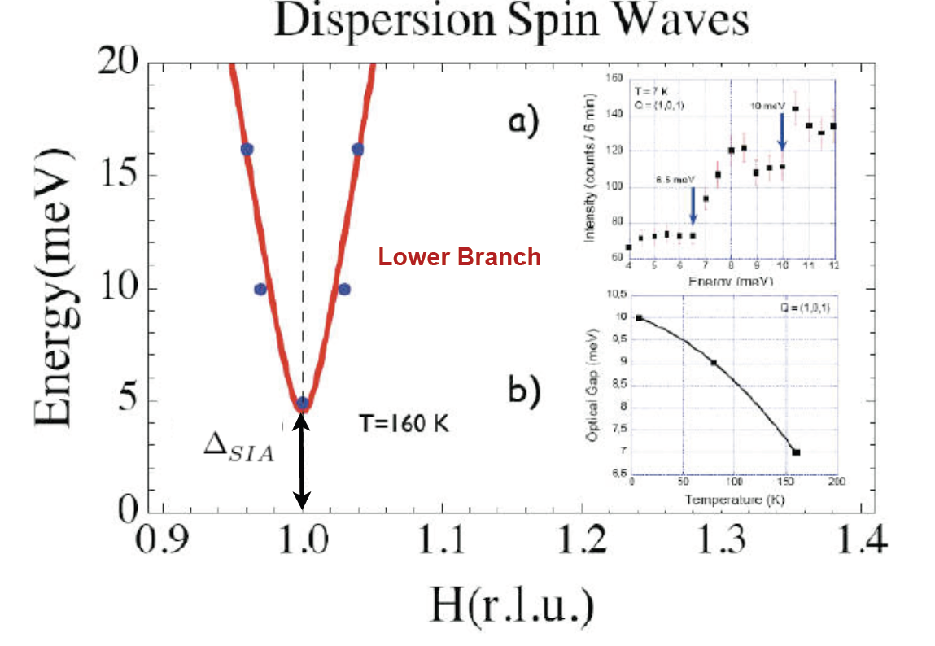

Slide 33
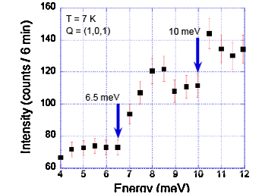
Neutron Scattering: Two Gaps!!!
J. Zhao et al., Phys. Rev. Lett. 101, 167203 (2008)

Slide 34
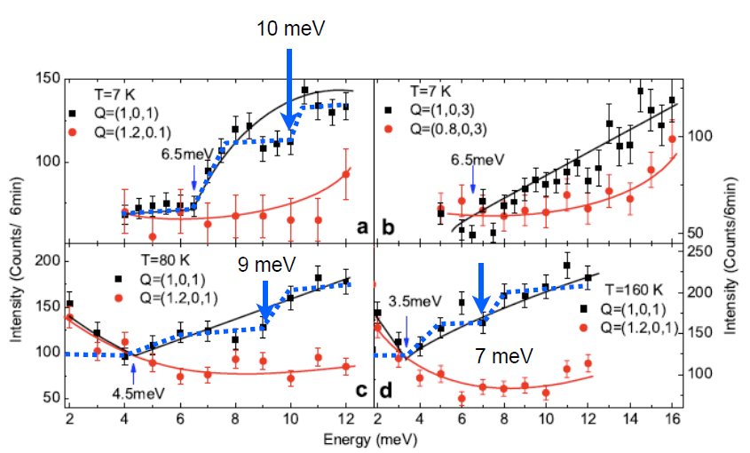
Two Steps in the Neutron Scattering Intensity
J. Zhao et al., Phys. Rev. Lett. 101, 167203 (2008).

Slide 35
6) Electronic Spectrum
Take the itinerant part…
and do mean field…
Replacing for its static equilibrium value

Slide 36
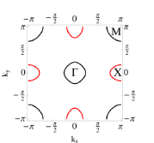
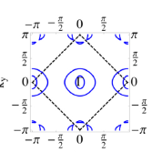
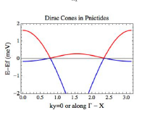
Fermi Surface and Dirac Cones
AF Ordering of Sublattice

Slide 37
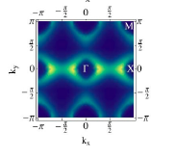
ARPES Results
Dirac cones
P. Richard et al., Phys. Rev. Lett. 104, 137001 (2010).

Slide 38
7) Conclusion and Perspectives
QFT is an efficient method for describing complex materials
The magnetic excitation spectrum of pnictides contains two gapped branches – seen in neutron scattering experiments
The electronic quasiparticle spectrum presents two Dirac cones – seen in ARPES experiments
Present and future research – specific heat, conductivity,…

Slide 39


Acknowledgements
Brazilian Funding Agencies

